Slide 1

MausamIQ – Indian Cities Weather Forecast Website
A real-time weather and air quality tracking website built for Indian cities.
Team Members: Ishu Garg (Leader), Vidhish (Project Manager & Frontend), Ayush (Frontend)

Slide 2

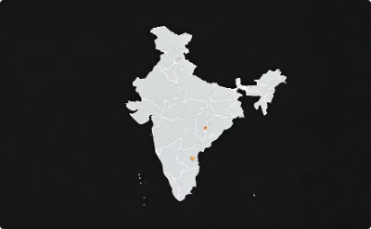

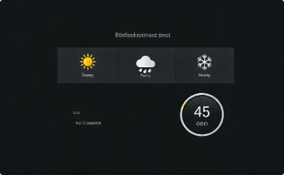
Project Overview
Responsive Design
Focused on Indian Cities
Real-time Updates
Weather & Air Quality
User-friendly interface that adapts to all devices
Constantly refreshed data from reliable weather APIs
Displays detailed weather and Air Quality Index information
Tailored weather forecasts specifically for cities across India

Slide 3
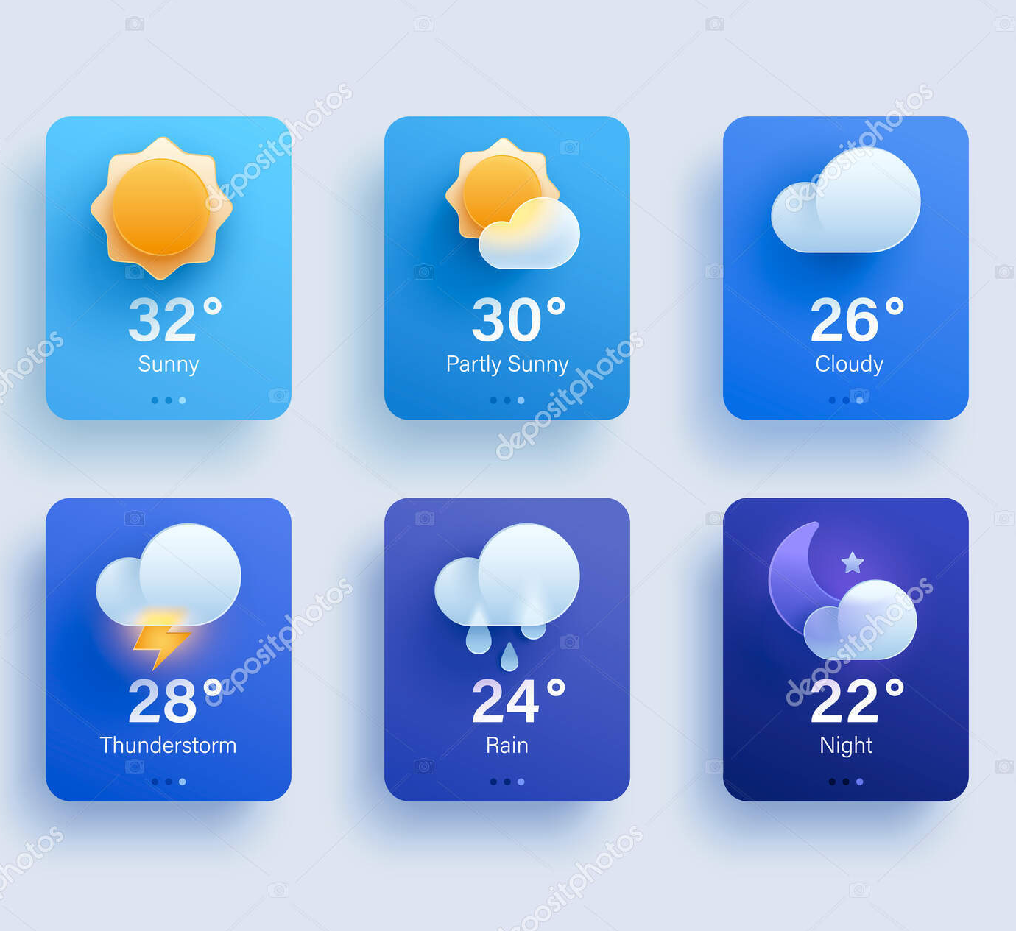
Project Objectives
Accurate real-time weather data
5-day forecasts for planning
Track Air Quality Index (AQI)
Visually appealing, responsive frontend

Slide 4
Key Features
🌦️ Real-time current weather data
🧭 5-day weather forecast
🌫️ Real-time AQI display
💧 Humidity & wind speed details
🌅 Sunrise & sunset timings
📱 Fully responsive design
🧑‍💻 Clean, interactive UI

Slide 5

Technologies Used
Frontend stack
APIs
HTML for structure
OpenWeatherMap: weather & forecasts
CSS for styling & responsiveness
AQICN: Air Quality Index data
JavaScript for logic & interactivity

Slide 6

API Integration
fetch() used to retrieve API data dynamically
City selection triggers data rendering instantly
API response parsed and displayed on UI
Error & loading state handling implemented

Slide 7

Frontend Design
Clean, modern UI layout
Fully responsive for devices
Weather icons & colour-coded AQI
User-friendly, minimal navigation

Slide 8




How It Works
Select city
Fetch real-time data
Display data
Temperature, humidity, wind speed
Sunrise & sunset
AQI and category
5-day forecast with icons

Slide 9
Team Roles & Contributions
Ishu Garg - Team Leader
Vidhish - Project Manager & Frontend Dev
Ayush - Frontend Developer
Project oversight, task coordination, QA
Timeline management, UI/UX implementation
Interactive UI, API integration, responsive design

Slide 10

Challenges Faced
API rate limits & error handling
Ensuring responsive design on all screens
Optimizing API fetch speed & load time
Coordination across a small team

Slide 11
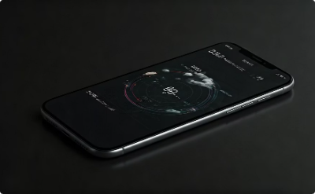

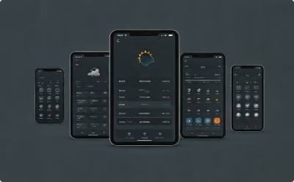

Conclusion
Accessible Data
Pure Frontend
Goals Achieved
Future Enhancements
Real-time weather and AQI for Indian cities
Built entirely with frontend technologies and public APIs
Accurate, responsive, and easy-to-use design
Voice search, dark mode, and city bookmarks planned

